Slide 1
Applied Data Science Capstone Project
Papawin Charoenchaipiyakul

Slide 2
Executive Summary
The data collected from SpaceX API and SpaceX Wikipedia. Then create a new label that classifies successful landings. The data explored by using SQL, visualization, folium maps, and dashboards. And use GridSearchCV to find best parameters by gathered relevant columns, create categorical dummies, and standardized data.
By using 4 models : Logistic regression, SVM, Decision Tree, and KNN. All model accuracy are about 83%.

Slide 3
Introduction
Background
SpaceX is a provider of space transportation with best pricing due to the ability to recover part of rocket after launch
SpaceY is another company that want to compete with SpaceX
Problem
SpaceY want to use machine learning to predict successful landings

Slide 4
Methodology

Slide 5
Methodology
Data collection methodology:
Combined data from SpaceX public API and SpaceX Wikipedia page
Perform data wrangling
Classifying true landings as successful and unsuccessful otherwise
Perform exploratory data analysis (EDA) using visualization and SQL
Perform interactive visual analytics using Folium and Plotly Dash
Perform predictive analysis using classification models
Tuned models using GridSearchCV

Slide 6
Data Collection
Data collected by
request API from SpaceX API
Web scarping from SpaceX Wikipedia page.

Slide 7
Data Collection - API
Request API
Json_normalize to DataFrame
Cast dictionary to DataFrame
Clean the missing value by using mean
Filter data to only have Falcon 9
Github URL:
https://github.com/alotofp/AppliedDataScienceCapstone/blob/main/Data%20Collection%20API%20Lab.ipynb

Slide 8
Data Collection – Web Scraping
Request from Wikipedia
Parser by BeautifulSoup
Create dictionary
DataFrame
Iterate through table cells to extract data to dictionary
Github URL:
https://github.com/alotofp/AppliedDataScienceCapstone/blob/main/Data%20Collection%20with%20Web%20Scraping.ipynb

Slide 9
Data Wrangling
Create a label with landing outcomes ( 1 = success and 0 = failure)
Outcome has two components: Mission Outcome and Landing Location
True ASDS, True RTLS and True Ocean -> 1
None None, False ASDS, Non ASDS, False Ocean and False RTLS -> 0
Github URL: https://github.com/alotofp/AppliedDataScienceCapstone/blob/main/Data%20Wrangling.ipynb

Slide 10
EDA with Data Visualization
Exploratory Data Analysis performed on variables Flight Number, Payload Mass, Launch Site, Orbit, Class and Year.
Scatter plots, line charts and bar plots were used to compared relationships between variables to decide if a relationship exists.
Github URL: https://github.com/alotofp/AppliedDataScienceCapstone/blob/main/EDA%20with%20Data%20Visualization.ipynb

Slide 11
EDA with SQL
Loaded data into IBM DB2 then queries using SQL Python integration
Github URL: https://github.com/alotofp/AppliedDataScienceCapstone/blob/main/EDA%20with%20SQL.ipynb

Slide 12
Build an interactive map with Folium
Folium map marks Launch Sited, landing outcomes and distance to key locations.
This allows to visualized landing outcomes related to location.
Github URL: https://github.com/alotofp/AppliedDataScienceCapstone/blob/main/Interactive%20Visual%20Analytics%20with%20Folium%20lab.ipynb

Slide 13
Predictive analysis (Classification)
Split label column from dataset
Fit and Transform Features
Split the data (train and test)
Create the confusion matrix
Find the accuracy on test data
Apply the model (GridSearchCV, Logistic regression, Decision Tree, KNN)
Github URL:
https://github.com/alotofp/AppliedDataScienceCapstone/blob/main/Machine%20Learning%20Prediction.ipynb

Slide 14
Insights drawn from EDA

Slide 15
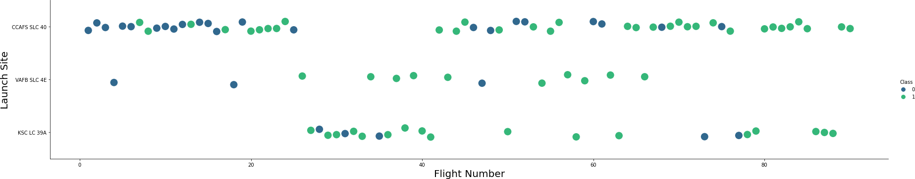
Flight Number vs. Launch Site
Graphic suggests an increase in success rate over time (indicated in Flight Number). Likely a big breakthrough around flight 20 which significantly increased success rate. CCAFS appears to be the main launch site as it has the most volume.

Slide 16
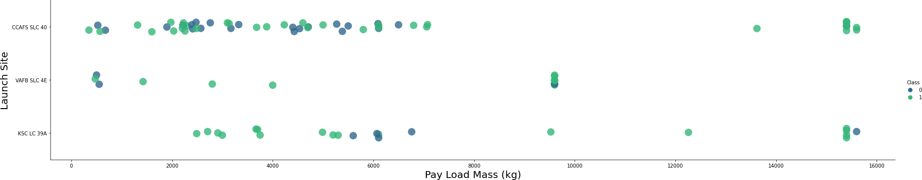
Payload vs. Launch Site
Payload mass appears to fall mostly between 0-6000 kg. Different launch sites also seem to use different payload mass.

Slide 17
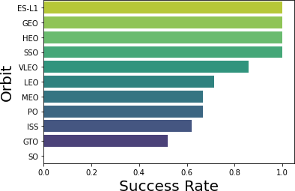
Success Rate vs. Orbit Type
ES-L1 (1), GEO (1), HEO (1) have 100% success rate (sample sizes in parenthesis) SSO (5) has 100% success rate
VLEO (14) has decent success rate and attempts
SO (1) has 0% success rate
GTO (27) has the around 50% success rate but largest sample

Slide 18
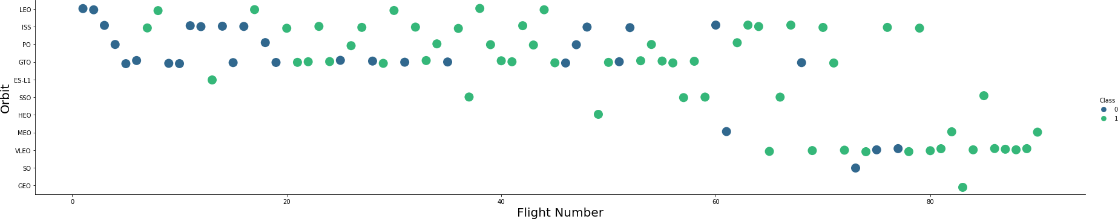
Flight Number vs. Orbit type
Launch Orbit preferences changed over Flight Number.
Launch Outcome seems to correlate with this preference.
SpaceX started with LEO orbits which saw moderate success LEO and returned to VLEO in recent launches
SpaceX appears to perform better in lower orbits or Sun-synchronous orbits

Slide 19
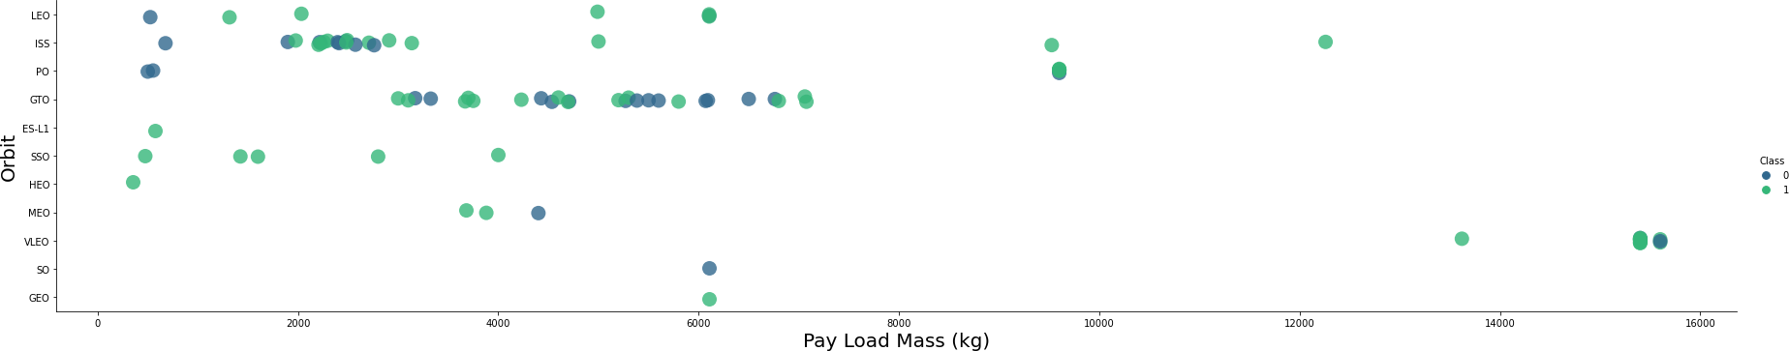
Payload vs. Orbit type
Payload mass seems to correlate with orbit
LEO and SSO seem to have relatively low payload mass
The other most successful orbit VLEO only has payload mass values in the higher end of the range

Slide 20
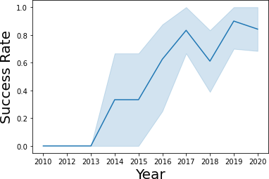
Launch Success Yearly Trend
Success generally increases over time since 2013 with a slight dip in 2018
Success in recent years at around 80%

Slide 21
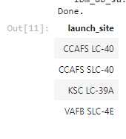
All Launch Site Names
Launch site names :
CCAFS LC-40
CCAFS SLC-40
KSC LC-39A
VAFB SLC-4E

Slide 22
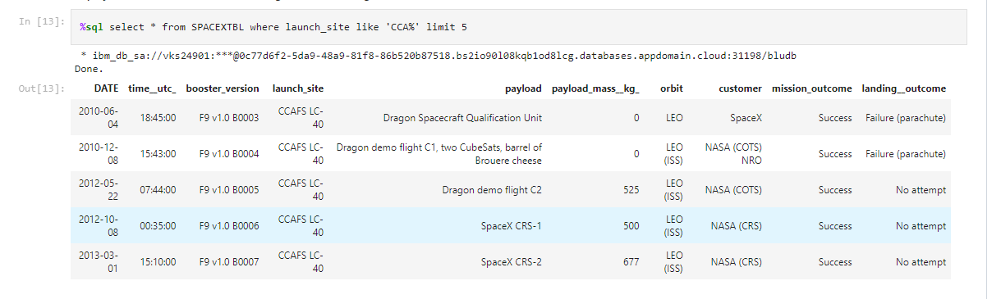
Launch Site Names Beginning with `CCA`
First five entries in database with Launch Site name beginning with CCA.

Slide 23
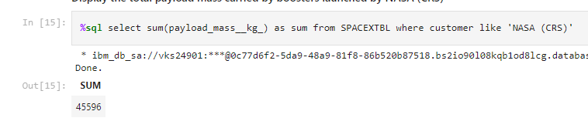
Total Payload Mass from NASA
This query sums the total payload mass in kg where NASA was the customer.

Slide 24
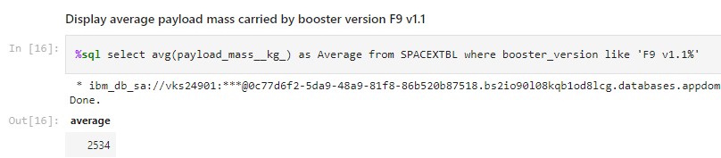
Average Payload Mass by F9 v1.1
This query calculates the average payload mass or launches which used booster version F9 v1.1

Slide 25
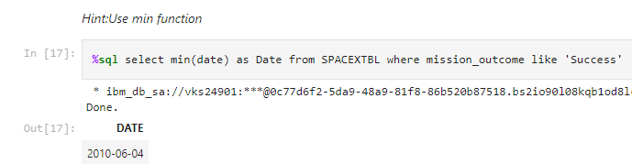
First Successful Ground Pad Landing Date
This query returns the first successful ground pad landing date.

Slide 26
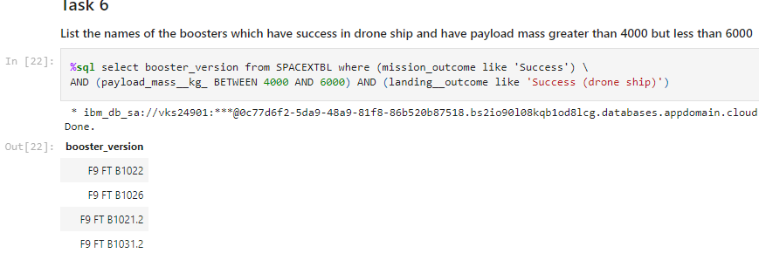
Successful Drone Ship Landing with Payload Between 4000 and 6000
This query returns the four booster versions that had successful drone ship landings and a payload mass between 4000 and 6000.

Slide 27
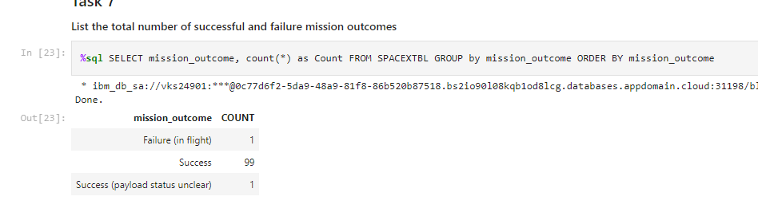
Total Number of Each Mission Outcome
This query returns a count of each mission outcome.

Slide 28
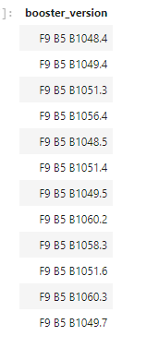
Boosters that Carried Maximum Payload
This query returns the booster versions that carried the highest payload mass.
These booster versions are very similar and all are of the F9 B5 B10xx.x variety.

Slide 29
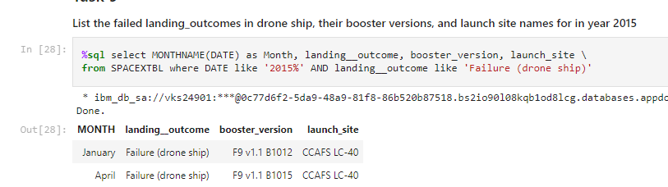
2015 Failed Drone Ship Landing Records
This query returns the Month, Landing Outcome, Booster Version, Payload Mass (kg), and Launch site of 2015 launches where stage 1 failed to land on a drone ship.

Slide 30
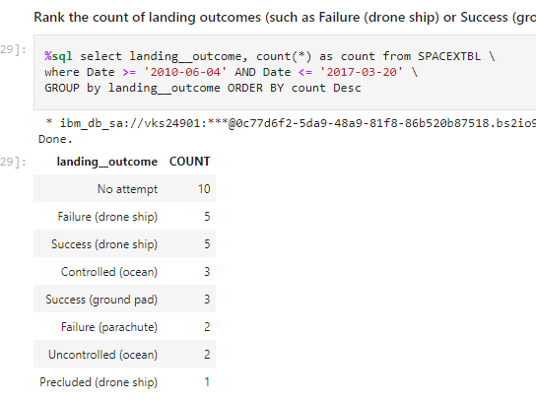
Ranking Counts of Successful Landings Between 2010-06-04 and 2017-03-20
This query returns a list of successful landings and between 2010-06-04 and 2017-03-20 inclusively.

Slide 31
Launch Sites Proximities Analysis

Slide 32
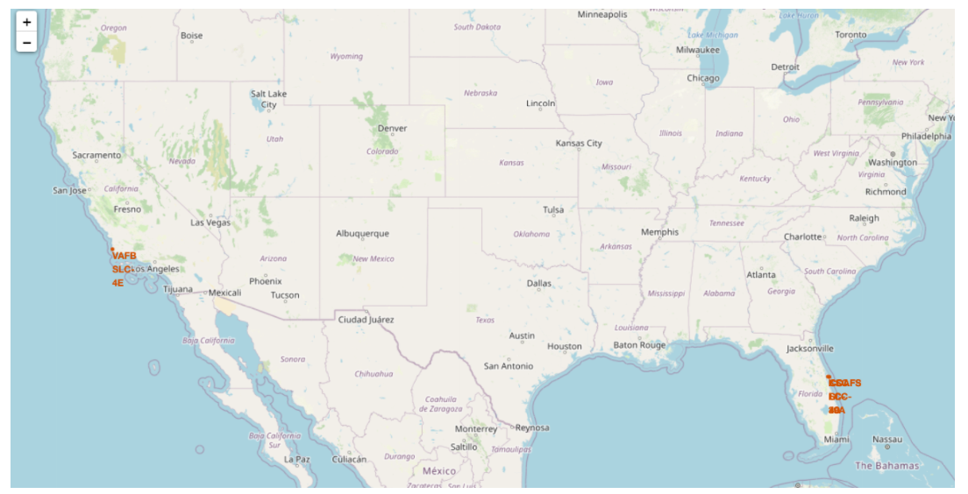
Launch Sites Locations
The map shows all launch sites relative USA map.

Slide 33
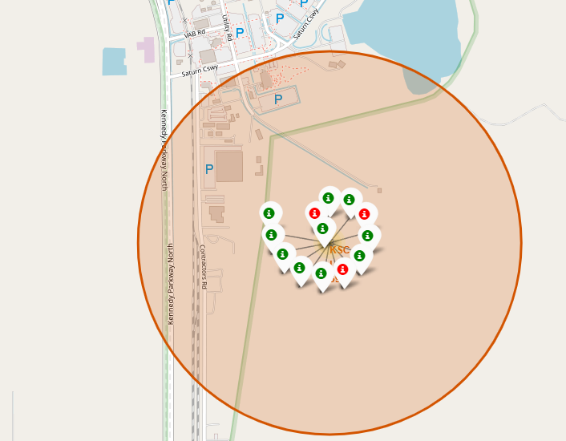
Color-Coded Launch Markers
Clusters on Folium map can be clicked on to display each successful landing (green icon) and failed landing (red icon).

Slide 34
Predictive Analysis (Classification)

Slide 35
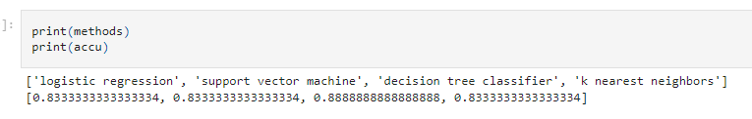
Classification Accuracy
All models have almost the same accuracy around 83%.
It should be noted that the test data size is relatively small with only 18 samples.
We need more data to determine the best model.

Slide 36
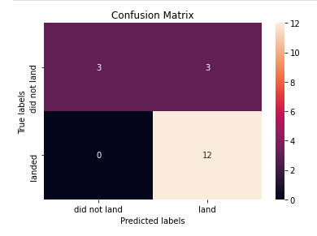
Confusion Matrix
Since all models performed the same for the test set, the confusion matrix is the same across all models.
The models predicted 12 successful landings when the true label was successful landing.
The models predicted 3 unsuccessful landings when the true label was unsuccessful landing.
The models predicted 3 successful landings when the true label was unsuccessful landing.

Slide 37
Conclusion
Problem: develop a machine learning model to predict the landing outcomes
Objective: create a model that can use to predict the landing outcome
Results: created models accuracy are around 83%
Data collected from SpaceX API and SpaceX Wikipedia
If possible more data should be collected to better determine the best machine learning model and improve accuracy

Slide 38
Appendix
Github repository URL: https://github.com/alotofp/AppliedDataScienceCapstone

